Slide 1
What is a meal you could eat daily and not tired of?
Simple braised beef with rice & sauce
Notes:
https://www.ncsc.gov.uk/static-assets/documents/PwnedPasswordsTop100k.txt

Slide 2

Ranking Business Functions by Criticality
Systematically ranking business functions by criticality is essential for effective business continuity. This process prioritizes recovery efforts, allocates resources during incidents, and protects critical operations from financial, operational, legal, or reputational impacts.
Learning Outcomes
Understand criticality assessment for continuity & risk management.
Identify and assess functions by key impact categories.
Apply structured scoring for objective ranking.
Align ranking with DRI Practices 3 & 4 (BIA & Strategy).
1
Notes:
Criticality = how essential a function is to business survival
Ranking shows what must recover first after disruption
Turns opinions into measurable priorities
Helps allocate resources where they matter most
Links to DRI Practices 3 & 4 (BIA & Strategy)
Builds resilience by knowing what’s most vital Example: Grocery store ranks “inventory system” above “marketing.” Cyber example: A bank ranks “transaction processing” above “internal chat tool.”

Slide 3
CLASS AGENDA
CLASS OBJECTIVES
Why function ranking matters for resilience
Overview of four impact dimensions
Scoring & weighting models
Prioritization techniques
Real-world applications discussion
Explain criticality types & implications
Apply weighted scoring methods
Link rankings to Recovery Time Objectives (RTOs)
Validate rankings cross-functionally

Slide 4

Why Rank Business Functions?
Business function ranking transforms subjective opinions into objective priorities, guiding strategic decisions, resource allocation, and crisis recovery.
Supports crisis prioritization
Optimizes resource allocation
Enables systematic recovery planning
Aids leadership decision-making
Aligns understanding of critical operations
Ensures regulatory compliance
Notes:
Gives clear recovery priorities
Improves crisis decision-making
Prevents resource waste on low-impact tasks
Ensures critical operations restart first
Helps prove compliance and audit readiness Example: Restaurant prioritizes “payment system” during outage. Cyber example: Company restores “email server” before “design server” after cyberattack.

Slide 5
The Four Dimensions of Criticality
Assessing business function criticality involves four key impact dimensions, revealing vulnerabilities and guiding balanced risk-based decisions.
Financial Impact
Operational Impact
Revenue loss, increased costs, contractual penalties, and market value effects.
Disruptions to service delivery, workflow, productivity, and dependencies.
Legal/Regulatory Impact
Reputational Impact
Compliance violations, regulatory fines, contract breaches, and legal liabilities.
Brand damage, loss of confidence, customer trust erosion, and competitive decline.
These dimensions provide a holistic view for comprehensive continuity planning.
Notes:
Financial = money loss or cost increase
Operational = service or workflow disruption
Legal/Regulatory = compliance or liability risk
Reputational = trust and brand damage
Combined, they give full risk visibility Example: Hospital outage delays patient care (operational). Cyber example: Data breach triggers fines and PR crisis (legal + reputational).

Slide 6

Financial Impact Assessment
Financial impact is the most quantifiable criticality dimension, focusing on measurable monetary consequences from business disruption.
Revenue loss (hourly, daily, extended outages)
Downtime costs (productivity, overtime, recovery)
Contractual penalties & SLA violations
Market share erosion & competitive disadvantage
Insurance deductibles & coverage gaps
Opportunity costs (delayed projects, missed deadlines)
Notes:
Tracks direct revenue or cost effects
Considers downtime cost and penalties
Includes insurance and market loss
Quantifies impact in money terms
Used to justify recovery spending Example: Factory halt costs $50k per day. Cyber example: Ransomware stops e-commerce orders for 24h = $200k loss.

Slide 7

Operational Impact Assessment
Evaluates how disruptions affect daily operations, service delivery, and productivity, often revealing critical dependencies.
Service delays
Internal workflow breakdowns
Lost productivity
Supply chain disruptions
Data processing delays
Notes:
Measures workflow and productivity hit
Shows how daily work stops or slows
Reveals key process dependencies
Includes internal and supply chain effects
Used to plan workarounds Example: Airport baggage delay slows all flights. Cyber example: ERP outage halts production tracking for 8 hours.

Slide 8

Legal and Regulatory Impact Assessment
Evaluates compliance consequences of disruption. Critical for demonstrating operational resilience and recovery capabilities under regulatory frameworks.
Regulatory breaches (fines, sanctions)
Contract violations (penalties, termination)
Data privacy breaches
Industry-specific compliance requirements
Legal liability for service failures
Audit findings and control issues
Notes:
Checks compliance and contract exposure
Fines, lawsuits, or data privacy risks
Includes audit or reporting failures
Needed for regulated industries
Helps define mandatory controls Example: Hospital violates patient record laws. Cyber example: GDPR breach leads to €2M fine.

Slide 9

Reputational Impact Assessment
Reputational impact evaluates how disruptions affect organizational credibility, stakeholder trust, and market position. This damage, though hard to quantify, can have long-lasting business consequences.
Brand damage and negative public perception
Erosion of customer trust
Loss of stakeholder confidence (investors, partners)
Negative media and social media impact
Competitive disadvantage
Employee morale and retention issues
Notes:
Measures trust and brand loss
Covers customer confidence and loyalty
Includes media or social fallout
Often long-lasting and hard to fix
Critical for public-facing services Example: Airline mishandles customer data, loses trust. Cyber example: Breach leaks user info, causing customer churn.

Slide 10








Combining Impact Dimensions
Comprehensive criticality assessment integrates all four impact dimensions for a complete evaluation.
Operational
Financial
Service delivery & productivity
Quantifiable monetary impact
Reputational
Legal/Regulatory
Brand trust & competitive position
Compliance & liability risks
Integrate with consistent scoring, appropriate weighting, and cross-functional validation.
Notes:
Combine all four for full analysis
Balance money, operations, law, and brand
Assign weight to what matters most
Use consistent scoring
Validate with multiple teams Example: Retailer weighs financial 40%, operational 30%, legal 20%, reputational 10%. Cyber example: Cloud provider uses same model for outage impact scoring.

Slide 11
Impact Scoring Scale
A consistent 5-point scale enables objective comparison across business functions and impact categories, ensuring practical application.
1 - Minimal
2 - Low
Minor inconvenience, negligible business impact. Functions can be delayed or manual.
Noticeable but manageable impact. Some productivity loss, no major disruption.
4 - High
5 - Critical
Severe impact, threatens business objectives. Potential customer defection, regulatory issues, or financial losses.
Catastrophic impact, threatens business viability. Permanent damage to operations, reputation, or finances.
Apply these scales consistently for meaningful comparison and accurate prioritization of recovery efforts.
Notes:
1 Minimal → minor delay, manual workaround
2 Low → small impact, manageable
3 Moderate → measurable disruption
4 High → serious harm, lost customers
5 Critical → business-threatening event Example: Coffee shop POS outage = “4 High.” Cyber example: Payment gateway down = “5 Critical.”

Slide 12
Example Scoring Table
This table shows how different business functions are scored across four impact dimensions, highlighting varying criticality.
Business Function
Financial
Operational
Legal/Regulatory
Reputational
Customer Payment Processing
5
5
4
4
Customer Service Center
3
4
2
4
Financial Reporting
2
3
5
3
Marketing Campaigns
2
2
1
2
Human Resources
1
2
3
2
Payment processing shows high impact across dimensions, while HR has lower immediate but higher regulatory impact. This process helps inform decision-making.
Notes:
Shows how each function scores per dimension
Makes ranking transparent and data-driven
Identifies high-priority recovery areas
Reveals compliance-heavy or revenue-critical gaps
Used to guide planning Example: HR = lower financial impact, higher legal impact. Cyber example: Payment system = high across all four categories.

Slide 13

Weighting Impact Categories
Prioritizing impact categories is crucial for tailoring criticality scores to an organization's specific values and requirements.
40%
30%
20%
Financial
Operational
Legal/Regulatory
High for revenue protection
Key for service delivery
Critical for compliance
10%
Reputational
Higher for brand-dependent orgs
Note: These percentages are an example. Customize weights based on risk profile, industry needs, and strategic priorities.
Notes:
Weight = how much each dimension counts
Reflects business values and priorities
Adjusts scores for industry or risk type
Aligns with strategy and regulations
Must be reviewed regularly Example: Airline gives 50% weight to operational impact. Cyber example: Bank gives 40% weight to financial, 30% to legal.

Slide 14
Using Weighted Scores to Rank Functions
Criticality ranking combines impact scores with organizational weights for objective, quantifiable results.
Calculation Formula
Total Criticality Score = (Financial × Weight) + (Operational × Weight) + (Legal × Weight) + (Reputational × Weight)
Example Calculation: Customer Payment Processing
1
2
Impact Scores
Apply Weights
Financial: 5, Operational: 5, Legal: 4, Reputational: 4
40% Financial, 30% Operational, 20% Legal, 10% Reputational
3
4
Calculate Score
Rank Functions
(5×0.4) + (5×0.3) + (4×0.2) + (4×0.1) = 4.7
Higher scores = greater criticality for resource allocation.
Systematic ranking reflects objective impact and strategic priorities.
Notes:
Combines impact and weight for objectivity
Produces total criticality score
Higher score = higher recovery priority
Makes resource decisions data-driven
Creates clear ranking for BIA Example: Payroll = 3.6, Sales = 4.8 → Sales ranked first. Cyber example: CRM system = 4.7 → prioritized for fast restore.

Slide 15

Prioritization Matrix
This matrix combines impact and probability to prioritize functions, guiding resource allocation and recovery strategy development.
High Impact / High Probability
Critical Priority: Invest in prevention & rapid recovery.
High Impact / Low Probability
High Priority: Develop strong, tested recovery plans.
Low Impact / High Probability
Medium Priority: Standard recovery; document workarounds.
Low Impact / Low Probability
Standard Priority: Basic documentation, minimal resources.
Notes:
Crosses impact with probability
High impact/high probability = top priority
Low impact/low probability = minimal focus
Guides resource and test planning
Helps visualize resilience risk zones Example: Fire risk to warehouse = high/high quadrant. Cyber example: DDoS on e-commerce = high impact/high probability.

Slide 16


Cross-Department Review
Cross-functional review validates criticality rankings, ensuring accuracy and departmental consensus. This process identifies gaps, resolves disagreements, and builds alignment.
Involve representatives from all affected business units.
Review scoring rationale and assessment criteria.
Validate dependency relationships.
Facilitate discussion to resolve discrepancies.
Document assumptions and decision criteria.
Obtain leadership endorsement for commitment.
Best Practice: Separate initial scoring from validation review to prevent groupthink.
Notes:
Validates scores across business units
Fixes bias or misunderstanding
Confirms dependencies
Builds shared accountability
Gains leadership sign-off Example: HR, Finance, and IT align on payroll recovery needs. Cyber example: Security and IT agree on restoring authentication servers first.

Slide 17
Common Ranking Errors
Understanding typical mistakes helps organizations avoid biases that undermine prioritization efforts. These often reflect organizational politics over objective impact analysis.
Overrating Visible Functions
Ignoring Dependencies
Political Influence
Prioritizing high-profile functions while undervaluing essential but less visible ones.
Overlooking critical lower-level functions that support multiple high-impact processes.
Allowing politics or departmental pressure to override objective assessment criteria.
Single Dimension Focus
Static Assessment
Focusing on one impact category (e.g., financial), neglecting other critical dimensions.
Assuming criticality is constant, ignoring changes due to timing or external factors.
Notes:
Overrating visible or public functions
Ignoring hidden dependencies
Letting politics override data
Focusing on one dimension only
Treating criticality as static Example: Marketing ranked higher than logistics by mistake. Cyber example: Ignoring DNS dependency during recovery planning.

Slide 18

Aligning Criticality with Recovery Time Objectives
Criticality rankings directly determine Recovery Time Objectives (RTOs) and Recovery Point Objectives (RPOs). Higher criticality demands faster recovery and greater investment.
1
Critical (Score 4.5+)
RTO: 1-4 hours (Hot site)
2
High (Score 3.5-4.4)
RTO: 4-24 hours (Warm site)
3
Medium (Score 2.5-3.4)
RTO: 1-3 days (Cold site)
4
Standard (Score <2.5)
RTO: 3-7 days (Standard recovery)
These RTO guidelines are starting points; refine them based on specific business needs and resources.
Notes:
High criticality = shorter RTO/RPO
Defines recovery investment level
Guides hot, warm, or cold site choice
Links scoring to response speed
Keeps priorities realistic and measurable Example: Payroll (critical) → RTO 4 hours. Cyber example: Database cluster (critical) → RTO 2 hours, RPO 15 mins.

Slide 19
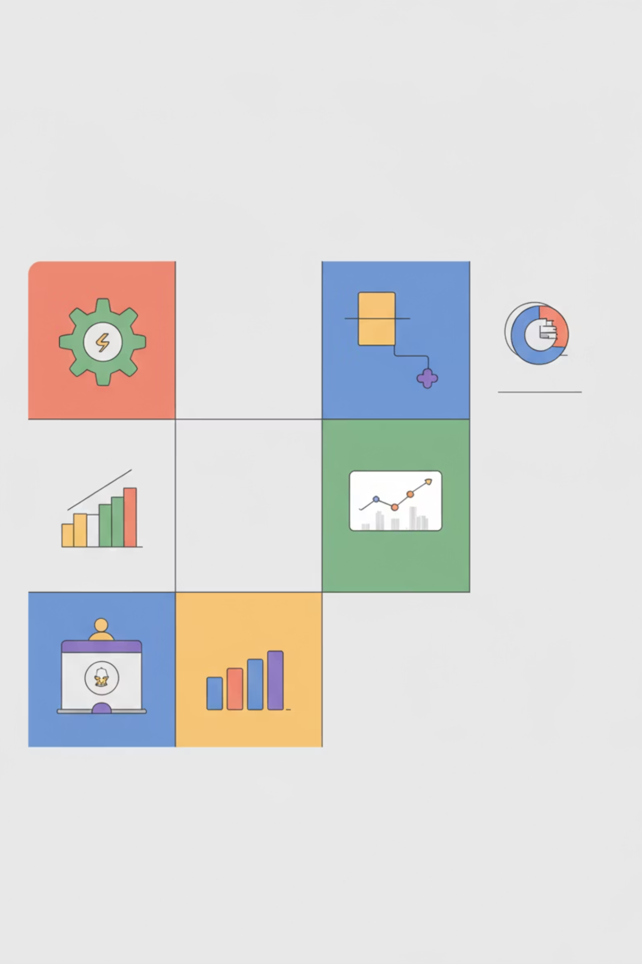
Using Criticality in Planning
Criticality informs all aspects of business continuity planning, from recovery sequencing to investment decisions.
Investment: Infrastructure, redundancy, recovery.
Staffing: Crisis response, recovery expertise.
Testing: Prioritize high-impact scenarios.
Vendors: Focus on critical suppliers.
Training: Operators of critical functions.
Insurance: Align coverage with risk.
This integrated approach ensures resources are allocated to strengthen organizational resilience effectively.
Notes:
Drives investment and testing focus
Informs staffing and vendor needs
Shapes insurance and training
Improves coordination across teams
Keeps plans aligned with risk tolerance Example: Company funds backup generators for top functions. Cyber example: Cloud firm sets rapid failover for Tier 1 systems.

Slide 20
Real-World Example: E-commerce Startup
Applying criticality ranking to an e-commerce startup reveals how function scores influence recovery priority.
Business Context
200-employee online retailer ($50M annual revenue) serving B2C/B2B via digital platform and physical fulfillment.
Function
Financial
Operational
Legal
Reputation
Total Score
Payment Processing
5
5
4
4
4.7
Order Management
4
5
3
4
4.2
Logistics/Shipping
4
4
2
3
3.5
Customer Service
2
3
2
4
2.7
Marketing Campaigns
2
2
1
2
1.9
Result: Critical functions like Payment Processing (RTO: 2 hrs) receive high priority, while Marketing (RTO: 5 days) uses standard recovery. This guides planning and crisis response.
Notes:
BIA ranks payment and order systems highest
Logistics medium, marketing lowest
Each gets recovery target (RTO/RPO)
Results guide budget and testing
Demonstrates data-driven decision-making Example: Payment system RTO 2 hrs vs. marketing RTO 5 days. Cyber example: Payment gateway restored first to resume revenue flow.

Slide 21

Summary & Key Takeaways
Criticality ranking transforms subjective opinions into objective priorities.
Four impact categories (Financial, Operational, Legal, Reputational) ensure comprehensive risk assessment.
Weighted scoring enhances objectivity and reflects organizational priorities.
Regular cross-functional review keeps rankings accurate and relevant.
Integrates with recovery planning: defines RTOs, resources, and testing.
Supports DRI Professional Practices for BIA and strategic continuity.
"Criticality ranking turns data into decisive action—transforming BIA into strategic advantage."
Criticality assessment is an ongoing process, evolving with your organization and threat landscape.
Notes:
Ranking = objective recovery priorities
Four dimensions: Financial, Operational, Legal, Reputational
Weighted scoring keeps it fair and relevant
Cross-team review prevents bias
Feeds directly into RTO, RPO, and resilience strategy Example: Restaurant rebuilds kitchen before décor after fire. Cyber example: IT recovers identity servers before analytics systems.

Slide 22
BREAK TIME
Be back in 15 mins.
Notes:
https://www.ncsc.gov.uk/static-assets/documents/PwnedPasswordsTop100k.txt

Slide 23

Determining RTOs and RPOs
RTOs and RPOs define critical recovery targets for time and data. These measurable objectives guide practical recovery strategies, aligning investments with business continuity needs.
Learning Outcomes
Define and differentiate RTOs & RPOs
Explain how RTOs & RPOs enhance organizational resilience
Link recovery objectives to Business Impact Analysis (BIA) and risk assessment
Align recovery planning with DRI Professional Practices 4 & 5
1
Notes:
RTO = maximum acceptable downtime
RPO = maximum acceptable data loss
Both define how fast and how much to recover
Set realistic targets based on criticality
Align with BIA and DRI Practices 4 & 5 Example: Coffee shop restarts POS in 2 hours after outage. Cyber example: Cloud provider restores database with only 15 minutes of data loss.

Slide 24
CLASS AGENDA
CLASS OBJECTIVES
RTO/RPO fundamentals
Realistic recovery thresholds
Factors influencing objective setting
Recovery priorities & tiers
Linking objectives to BIA
Application & validation
Calculate RTOs/RPOs for system criticality
Understand dependencies impacting recovery targets
Integrate objectives into continuity planning
Validate objectives via testing & improvement
Apply concepts to DRI scenarios

Slide 25

Why RTOs and RPOs Matter
RPO, RTO, and Business Impact Analysis (BIA) form the foundation for effective business continuity. Clear objectives prevent both over-engineering and dangerous under-preparation of recovery solutions.
Establish measurable recovery goals
Avoid over- or under-engineering solutions
Allocate resources cost-effectively based on criticality
Define testable success criteria for recovery plans
Guide technology and investment decisions
Ensure regulatory compliance and stakeholder confidence
Notes:
Prevent over- or under-prepared recovery plans
Set measurable resilience goals
Optimize cost and performance
Help meet regulations
Build confidence with customers and partners Example: Factory sets machine downtime limit to 8 hours. Cyber example: Financial firm designs backup to meet 1-hour RTO for trading systems.

Slide 26

What is Recovery Time Objective (RTO)?
Recovery Time Objective (RTO) is the maximum acceptable duration for business operations to be offline after a disruption, focusing on how quickly services must be restored.
Defines maximum acceptable downtime
Focuses on operational resumption speed
Measured based on criticality (seconds to days)
Guides recovery technology & procedures
Considers dependencies & restoration order
Balances business needs with cost & feasibility
Notes:
Defines how long a system can be offline
Measured from disruption to full recovery
Depends on system importance
Drives recovery order and budget
Must be tested and realistic Example: Call center phones must be back in 2 hours. Cyber example: Email server RTO = 4 hours to restore communication.

Slide 27
What is Recovery Point Objective (RPO)?
Recovery Point Objective (RPO) defines the maximum acceptable data loss an organization can sustain after a disaster. It focuses on setting the standard for data protection and loss tolerance.
Maximum acceptable data loss (measured in time)
Determines how much data can be lost without critical impact
Guides backup frequency and replication requirements
Varies based on data type and business criticality
Influences recovery strategy design (independent of RTO)
Drives technology investments for data protection
Notes:
Defines how much data loss is acceptable
Measured in time (minutes or hours)
Guides backup frequency
Impacts storage and network design
Independent from RTO Example: Retailer can afford 4 hours of lost sales data. Cyber example: Database backup every 15 minutes to keep RPO within target.

Slide 28
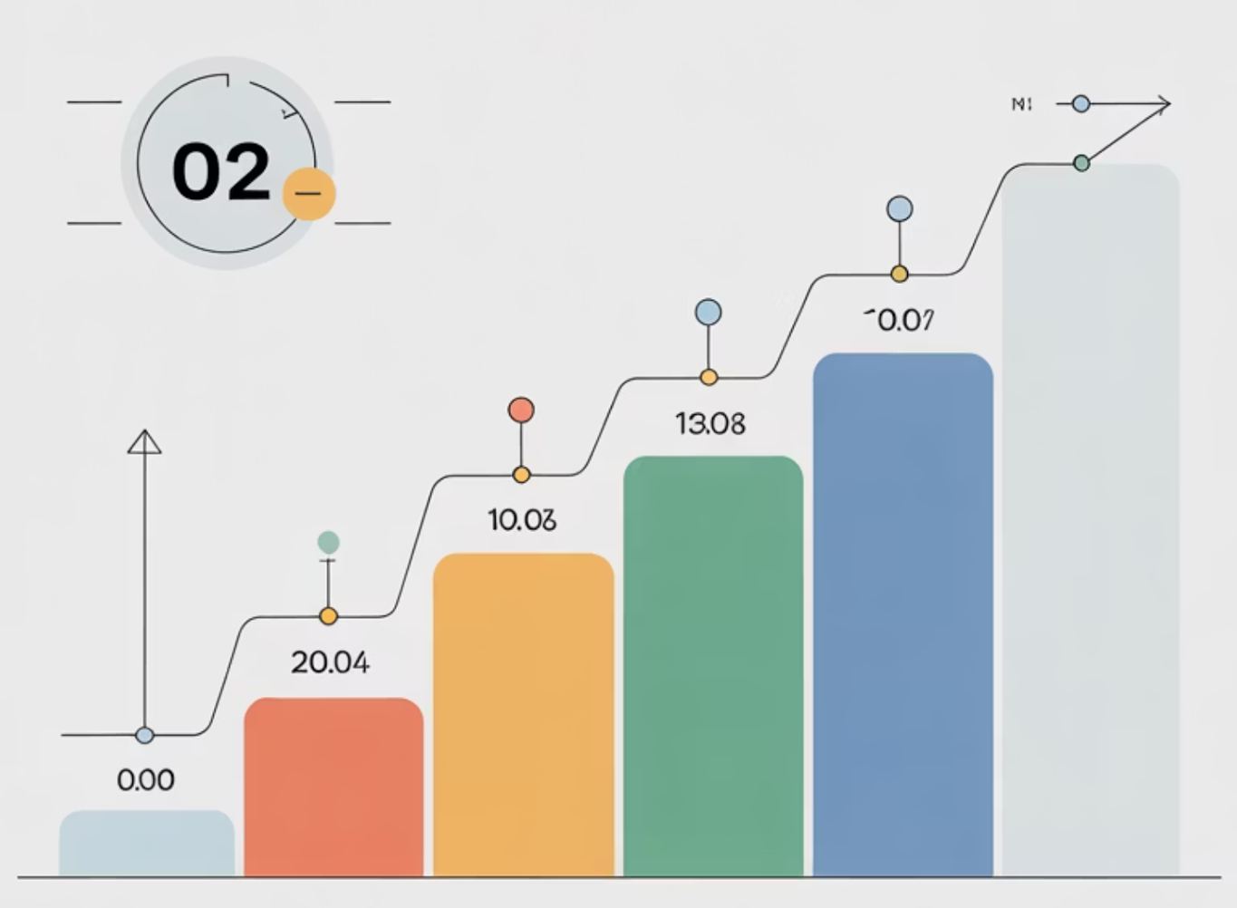
RTO vs RPO: Key Differences
RTO focuses on service downtime, while RPO addresses acceptable data loss. Understanding these distinctions is critical for designing effective recovery strategies.
RTO
Restore operations time
Forward-looking
Drives recovery procedures
Focuses on service availability
RPO
Data loss tolerance
Backward-looking
Drives backup policies
Focuses on data integrity
Notes:
RTO = time to restore operations
RPO = data loss tolerance
RTO is forward-looking; RPO is backward-looking
Both guide recovery strategy
One affects uptime, the other affects data integrity
Example: Shop can reopen in 6 hours (RTO), but loses only 1 hour of sales data (RPO).
Cyber example: Server restored in 2 hours, data rolled back to last 30-minute backup.

Slide 29

Factors Affecting RTO and RPO
The appropriate RTO and RPO values are influenced by several key factors. Prioritize systems that drive business and revenue, assigning them lower RTOs and RPOs.
System criticality & business impact
Data volume & complexity
Recovery costs vs. acceptable loss
Regulatory & compliance needs
Available technology & infrastructure
System interdependencies
Notes:
Business and system criticality
Data size and complexity
Cost of recovery vs. downtime loss
Regulatory requirements
Technology capability and dependencies Example: Airline sets tighter RTO for booking than for marketing. Cyber example: Bank invests in replication to meet strict compliance RPOs.

Slide 30
Linking to Business Impact Analysis (BIA)
A Business Impact Analysis (BIA) assesses the impact of downtime on critical business functions, helping define acceptable outage duration and data loss.
1
2
Identify Critical Functions
Assess Impact Over Time
Catalog key business processes & systems based on importance & revenue.
Determine financial, operational, regulatory consequences of downtime.
3
4
Define Tolerance Thresholds
Set Recovery Objectives
Establish max acceptable downtime & data loss before critical impact.
Translate business tolerance into specific RTO & RPO targets.
Notes:
Identify critical systems and functions
Assess impact over time
Define acceptable outage and data loss
Convert to recovery objectives
Keep consistent with BIA results Example: Payroll downtime beyond 12 hours = missed salaries. Cyber example: ERP outage > 6 hours affects supplier payments.

Slide 31

Setting Practical RTOs
Achieving a zero RTO is often costly and complex. Stakeholders must collaborate to set realistic RTO requirements that balance business needs with technical capabilities.
Balance business needs with available technology
Include full recovery sequences and dependencies
Account for human factors and communication
Incorporate testing results and historical data
Build in safety margins for complications
Align with resources, budget, and expertise
Notes:
Zero RTO is too expensive for most
Consider full recovery steps, not theory
Include communication and manual workarounds
Use test results to adjust
Align with resources and reality Example: Restaurant accepts 8-hour POS downtime. Cyber example: Web app aims for 2-hour RTO after system crash.

Slide 32
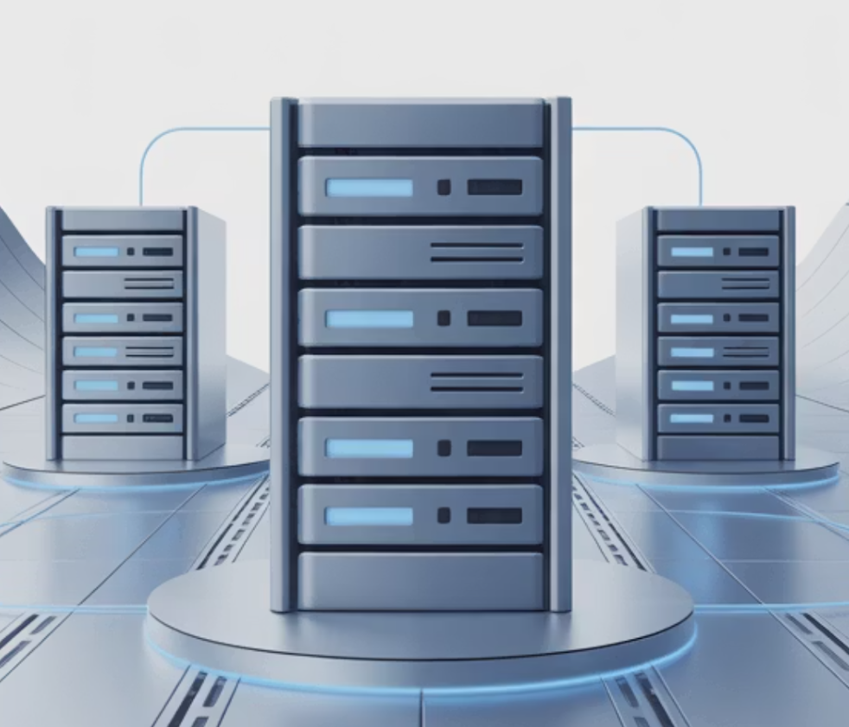
Setting Practical RPOs
RPO (Recovery Point Objective) defines the maximum acceptable data loss. For example, a 4-hour RPO means data must be backed up at least every four hours. More frequent backups increase cost without always adding business value.
Define backup frequency based on data loss tolerance
Consider data change rates and transaction volumes
Balance frequent backup costs with acceptable data loss
Account for backup window timing and system performance impact
Include data validation and restoration testing
Balance storage costs with RPO precision
Notes:
Frequent backups reduce data loss
Balance between cost and tolerance
Factor in system performance and storage
Include restore validation
Match RPOs to data type Example: CRM backs up daily; sales system every hour. Cyber example: Database replication keeps RPO under 10 minutes for orders.

Slide 33
Example: E-commerce Platform
Different systems within an organization require varied recovery objectives based on their business impact.
Order Processing System
Marketing Data Platform
Historical Analytics
RTO: 1 hour
RTO: 24 hours
RTO: 72 hours
RPO: 15 minutes
RPO: 12 hours
RPO: 24 hours
Critical for revenue generation. Requires rapid recovery and high-frequency backups to minimize transaction loss.
Important for campaign management, but not revenue-critical. Longer recovery is acceptable with scheduled backups.
Strategic planning data with lower urgency. Extended recovery acceptable with daily backup cycles.
Notes:
Different systems, different targets
Order Processing: RTO 1h, RPO 15m
Marketing: RTO 24h, RPO 12h
Analytics: RTO 72h, RPO 24h
Align recovery investment by value Example: Orders resume first, marketing later. Cyber example: Transaction system restored before analytics dashboard.

Slide 34

Recovery Tiers and Priorities
Organize systems into recovery tiers by criticality, aligning recovery objectives to optimize resources and sequencing.
Tier 1 - Critical
1
Mission-critical: RTO < 4h, RPO < 1h
Tier 2 - Essential
2
Important functions: RTO < 24h, RPO < 8h
Tier 3 - Standard
3
Supporting operations: RTO < 72h, RPO < 24h
Tier 4 - Non-essential
4
Administrative: RTO < 1 week, RPO < 72h
Notes:
Tier 1: Mission-critical, fastest recovery
Tier 2: Essential, within a day
Tier 3: Standard, within 3 days
Tier 4: Non-essential, within a week
Enables structured sequencing and budgeting Example: Hospital triages emergency systems first. Cyber example: Financial apps in Tier 1, HR tools in Tier 3.

Slide 35

Tools and Technologies Supporting RTO/RPO
Technology choices should align with recovery objectives, not dictate them. Stringent RTO/RPO values are more costly. Prioritize based on criticality tiers, then find cost-effective solutions.
Automated Backups (configurable frequency)
Real-time Replication & Data Mirroring
Failover Clustering (High Availability)
Cloud DR & BaaS Solutions
Snapshot Technologies (Point-in-Time Recovery)
Orchestration Tools (Automated Recovery)
Notes:
Backups and snapshots
Real-time replication
Failover clusters
Cloud DR and BaaS
Automated orchestration tools Example: Store uses daily backups for point-of-sale data. Cyber example: Cloud mirror restores systems in minutes after server failure.

Slide 36

Validation and Testing
Regularly testing your Business Continuity Management (BCM) plan helps identify gaps between planned RTO/RPO and actual recovery. Untested processes often lead to major problems during a real disaster.
Scheduled testing confirms RTO/RPO achievability
Tabletop exercises validate processes and team readiness
Technical tests verify backup integrity and restoration speed
End-to-end simulations include business process validation
Document test results, identify improvement areas
Continuously refine based on lessons learned
Notes:
Confirms if RTOs and RPOs are achievable
Tests processes and team readiness
Simulates real-world disruptions
Documents gaps and lessons learned
Keeps recovery plans current Example: Monthly fire drill tests office readiness. Cyber example: Annual restore test validates 2-hour database recovery claim.

Slide 37


Summary and Key Takeaways
RTO: Recovery Time Objective; RPO: Data Loss Tolerance.
Derived from Business Impact Analysis (BIA).
Objectives guide technology, testing, and resources.
Regular testing validates business alignment.
Tiered approach: optimizes costs, protects critical functions.
"Clear recovery objectives transform resilience from theory into execution."
Next Steps: Apply RTO/RPO concepts to your BIA. Establish realistic recovery tiers and validate through structured testing.
Remember: RTOs and RPOs must evolve with business and technology changes.
Notes:
RTO = downtime limit, RPO = data loss limit
Derived from BIA and linked to risk tolerance
Guides investment and recovery design
Testing ensures alignment and trust
Tiered recovery saves cost and improves focus Example: Bakery restores ovens first to restart sales. Cyber example: Security firm prioritizes SOC servers for rapid recovery.

Slide 38
Lab Time
1 Hour
Notes:
https://www.ncsc.gov.uk/static-assets/documents/PwnedPasswordsTop100k.txt

Slide 39

BIA Assessment Build-Out: Student Presentations and Recap
Students will now share the results of their BIA lab exercise, demonstrating how they identified critical functions, dependencies, and recovery priorities for a fictional startup. This session consolidates learning from the hands-on BIA build-out activity.
Session Goals
Showcase completed BIAs from the lab exercise
Discuss key takeaways from the group activity
Compare approaches across teams
Reinforce connections to real-world resilience planning
Notes:
Teams present results from BIA lab
Show critical functions and recovery priorities
Explain impact categories and dependencies
Compare how startups approached resilience
Display team BIA findings
Share key lessons from group work
Discuss similarities and differences
Connect results to business resilience
Practice communicating continuity logic Example: Students show how HR and finance overlap in continuity plans. Cyber example: Team explains how cloud sync supports data recovery speed.

Slide 40

Student Presentation Highlights
Students present their BIA findings and explain how their fictional startup approached the assessment process.
Presentation Elements
Each team introduces their startup concept and business model
Walk through their most critical business functions and processes
Explain dependencies and how recovery priorities were determined
Discuss challenges and tradeoffs in defining impact criteria and time frames
Notes:
Each team explains its startup model
Identify most critical functions
Show how dependencies shape impact
Discuss difficult tradeoffs in ranking
Compare how timeframes were defined Example: Logistics startup ranks “shipment tracking” as top priority. Cyber example: SaaS startup sets 1-hour RTO for customer platform.

Slide 41

Comparing Team Approaches
Highlight how each team interpreted criticality, impact assessment, and dependency mapping differently based on their startup scenarios.
Key Observations
Variations in startup types (e.g., SaaS, fintech, logistics, healthtech)
Common trends in identifying key systems and critical data assets
Observations about how teams balanced RTOs and RPOs
Lessons on collaboration between Resilience and IT teams during assessment
Notes:
Review how teams balanced RTOs and RPOs
Note differences by industry type
Highlight common dependency patterns
Identify what worked and what didn’t
Encourage peer feedback and refinement Example: Healthtech team focuses on data privacy, not speed. Cyber example: E-commerce team gives replication higher priority than backups.

Slide 42

Discussion Questions
What surprised you most during your BIA build-out process?
Which data points were hardest to estimate or gather?
How would this process change for a larger, more complex organization?
What improvements would you make to your approach next time?

Slide 43

Recap and Key Takeaways
Essential Learnings
BIA builds awareness of what keeps the business running by correlating information systems with critical business processes
Collaboration between teams strengthens understanding of dependencies across facilities, personnel, technology, and third-party providers
Realistic data and prioritization are key to resilience success, enabling objective analysis and informed decision-making
Building a BIA isn't about the spreadsheet — it's about aligning people, processes, and priorities.
Notes:
BIA connects people, process, and technology
Builds awareness of what keeps business running
Collaboration strengthens understanding of dependencies
Realistic data ensures credible results
Goal is alignment, not perfection Example: Company sees payroll, not marketing, drives resilience planning. Cyber example: IT team learns SOC alerting must be restored before analytics tools.

Slide 44
Kahootz & Quiz Time
Notes:
https://www.ncsc.gov.uk/static-assets/documents/PwnedPasswordsTop100k.txt

